Slide 1

Unit 1: Lesson 1
Two peas in a pod
U ovoj ćeš lekciji ponoviti izraze za opis obitelji, naučiti nekoliko izraza na australskom jeziku te izraziti mišljenje o muško-ženskom prijateljstvu.

Slide 2
Open your book, page 12.
Task 1: Have you got a lot of friends?
Are they girls or boys only?
Can boys and girls be friends?

Slide 3

Two peas in a pod
middle name = siblings =
divorced = nutritionist =
adorable = needy =
suburbs =
stepdad =
unit =
calm =
understanding =
impulsive =
srednje ime
braća i sestre
razveden
nutricionist
divan
koji traži pažnju
predgrađe
očuh
stambena jedinica, stan
miran
pun razumijevanja
impulzivan

Slide 4
Task 2:
Read the text and fill the table with
the correct words and expressions.
middle name Rose
lives with parents
the oldest child in the family
mum’s an IT expert
impulsive
middle name Ron
parents are divorced
the youngest child in the family
mum’s a teacher
calm and understanding
Melbourne
adorable

Slide 5
Task 3: Read the text again. Are the sentences true (T) or false (F)?
Task 4: Match the words to their definitions.
Task 5: Complete the sentences.
The benefits of boy-girl friendship are…
The downsides of boy-girl friendship are…
F
T
F
F
T
F
F
T
4
5
2
9
3
1
8
6
7

Slide 6
Task 6: Go online and find examples of names used both for girls and boys.
Study the Fun fact and Australian English box.

Slide 7
Open your workbook, page 6.
Task 1: Sort out the names in the table.
Joshua
Chris
Oliver
Luke
Phillip
Tom
Chloe
Angela
Emma
Meghan
Amy
Lucy
Sam
Ryan
Taylor
Jordan
Reese
Alex

Slide 8
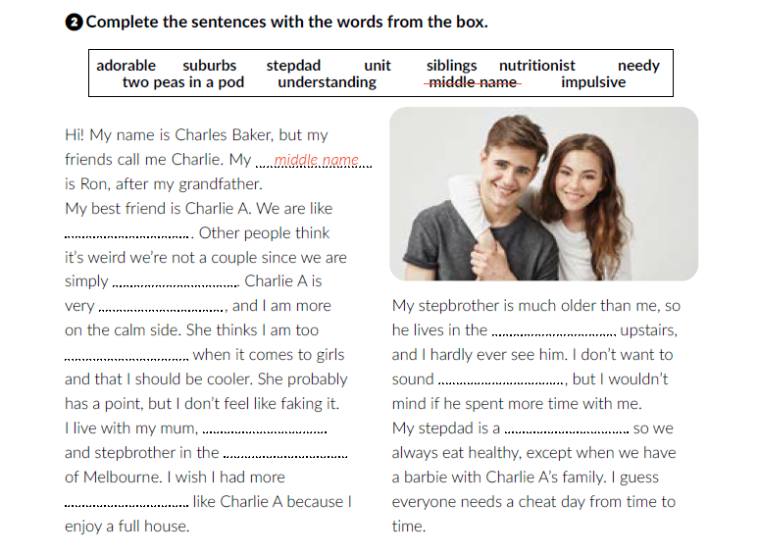
Task 2: Complete the sentences with the words from the box..
two peas in a pod
adorable
impulsive
unit
understanding
needy
stepdad
nutritionist
suburbs
siblings

Slide 9
Task 3: Rewrite the text in the third person singular.
His name is Charles Baker, but his friends call him Charlie. His middle name is Ron, after his grandfather.
His best friend is Charlie A. They are like two peas in a pod. Other people think it’s weird they’re not a couple since they are simply adorable. Charlie A is very impulsive, and he is more on the calm side. She thinks he is too understanding when it comes to girls and that he should be cooler. She probably has a point, but he doesn’t feel like faking it.
Charlie lives with his mum, stepdad and stepbrother in the suburbs of Melbourne. He wishes he had more siblings like Charlie A because he enjoys a full house. His stepbrother is much older than him, so he lives in the unit upstairs, and he hardly ever sees him. He doesn’t want to sound needy, but he wouldn’t mind if his stepbrother spent more time with him.
Charlie’s stepdad is a nutritionist, so they always eat healthy, except when they have a barbie with Charlie A’s family. He guesses everyone needs a cheat day from time to time.

Slide 10
Task 4: Answer the questions.
Task 6: Solve the riddles.
Alison
4
mother
three people: a son, a father and a grandfather

Slide 11

Otvori sljedeću poveznicu, te odaberi PLAY AND LEARN!
https://wordwall.net/play/18437/462/844

